Slide 1
Data Analysis of Railway services UK
By Ahmad Saraj

Slide 2
Project Objectives:
Identify the most popular routes
Determine peak travel times
Analyse revenue from different ticket types & classes
Diagnose on-time performance and contributing factors and many other analysis

Slide 3
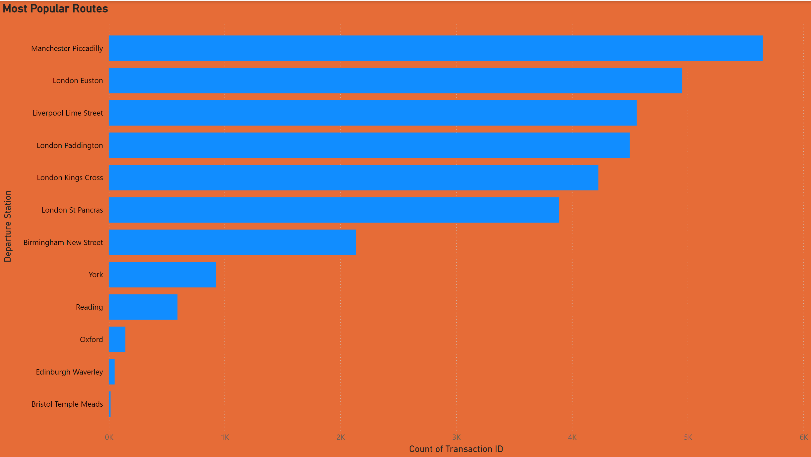
Identify the most popular routes

Slide 4
Insight of Most Popular Routes
The most popular routes based on the number of transactions are:
Manchester Piccadilly
London Euston
Liverpool Lime Street
London Paddington
London King's Cross
Manchester Piccadilly has the highest number of transactions, suggesting it is a major hub for passengers.

Slide 5
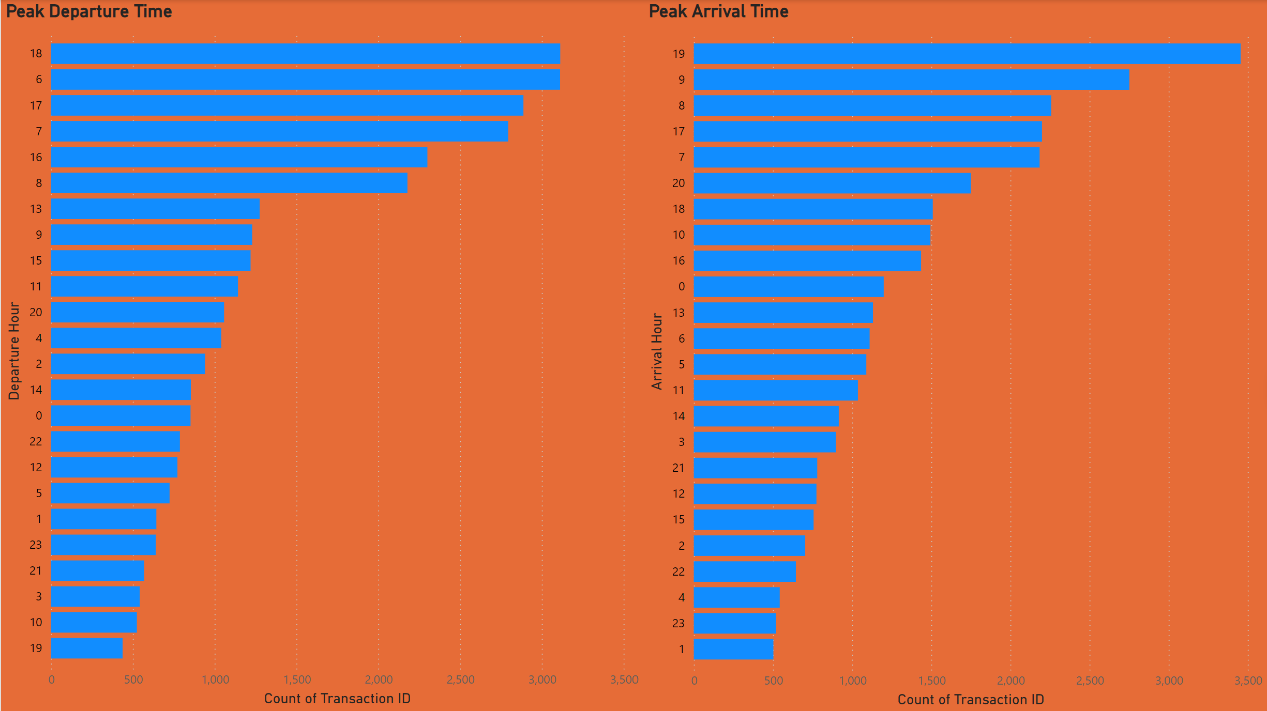
Determine peak travel times

Slide 6
Insights of Peak Departure Times
The peak departure hours are:
18:00 (6 PM)
06:00 (6 AM)
17:00 (5 PM)
This suggests that there are two main peaks: one in the early morning and one in the late afternoon/evening, likely corresponding to commuter traffic.

Slide 7
Insights of Peak Arrival Times
The peak arrival hours are:
19:00 (7 PM)
09:00 (9 AM)
17:00 (5 PM)
Similar to departures, there are noticeable peaks in the morning and evening, aligning with typical workday commuting patterns.

Slide 8
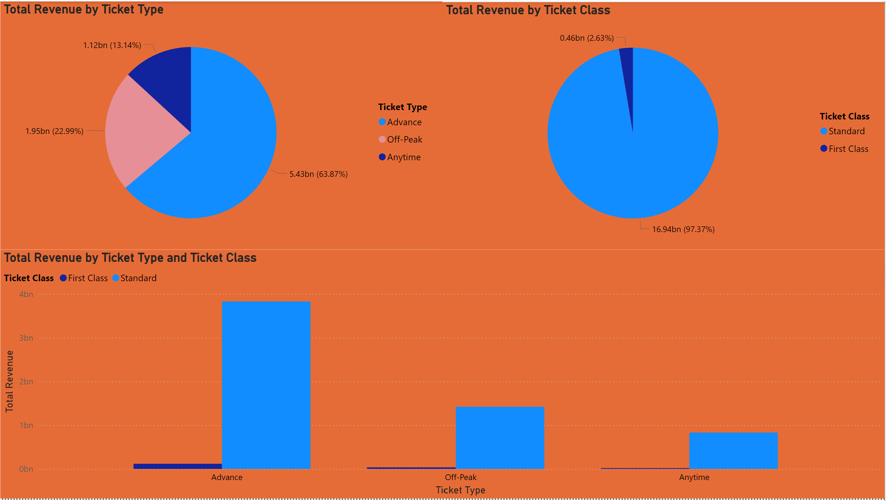
Analyse revenue from different ticket types & classes

Slide 9
Total Revenue by Ticket Type
Revenue distribution by ticket type is as follows:
Advance tickets: £5.43 billion (63.87%)
Off-Peak tickets: £1.95 billion (22.9%)
Anytime tickets: £1.12 billion (13.14%)
Advance tickets generate the most revenue, suggesting a high demand for pre-booked travel.

Slide 10
Total Revenue by Ticket Class
Revenue distribution by ticket class is:
Standard Class: £16.94 billion (97.37%)
First Class: £0.46 billion (2.63%)
Standard class tickets dominate the revenue, indicating that most passengers prefer or opt for standard class travel.

Slide 11
Total Revenue by Ticket Type and Class
Advance tickets generate significantly more revenue in both standard and first class compared to off-peak and anytime tickets.
There is a clear preference for advance tickets across both classes, but the revenue from first class is relatively small compared to standard class.

Slide 12
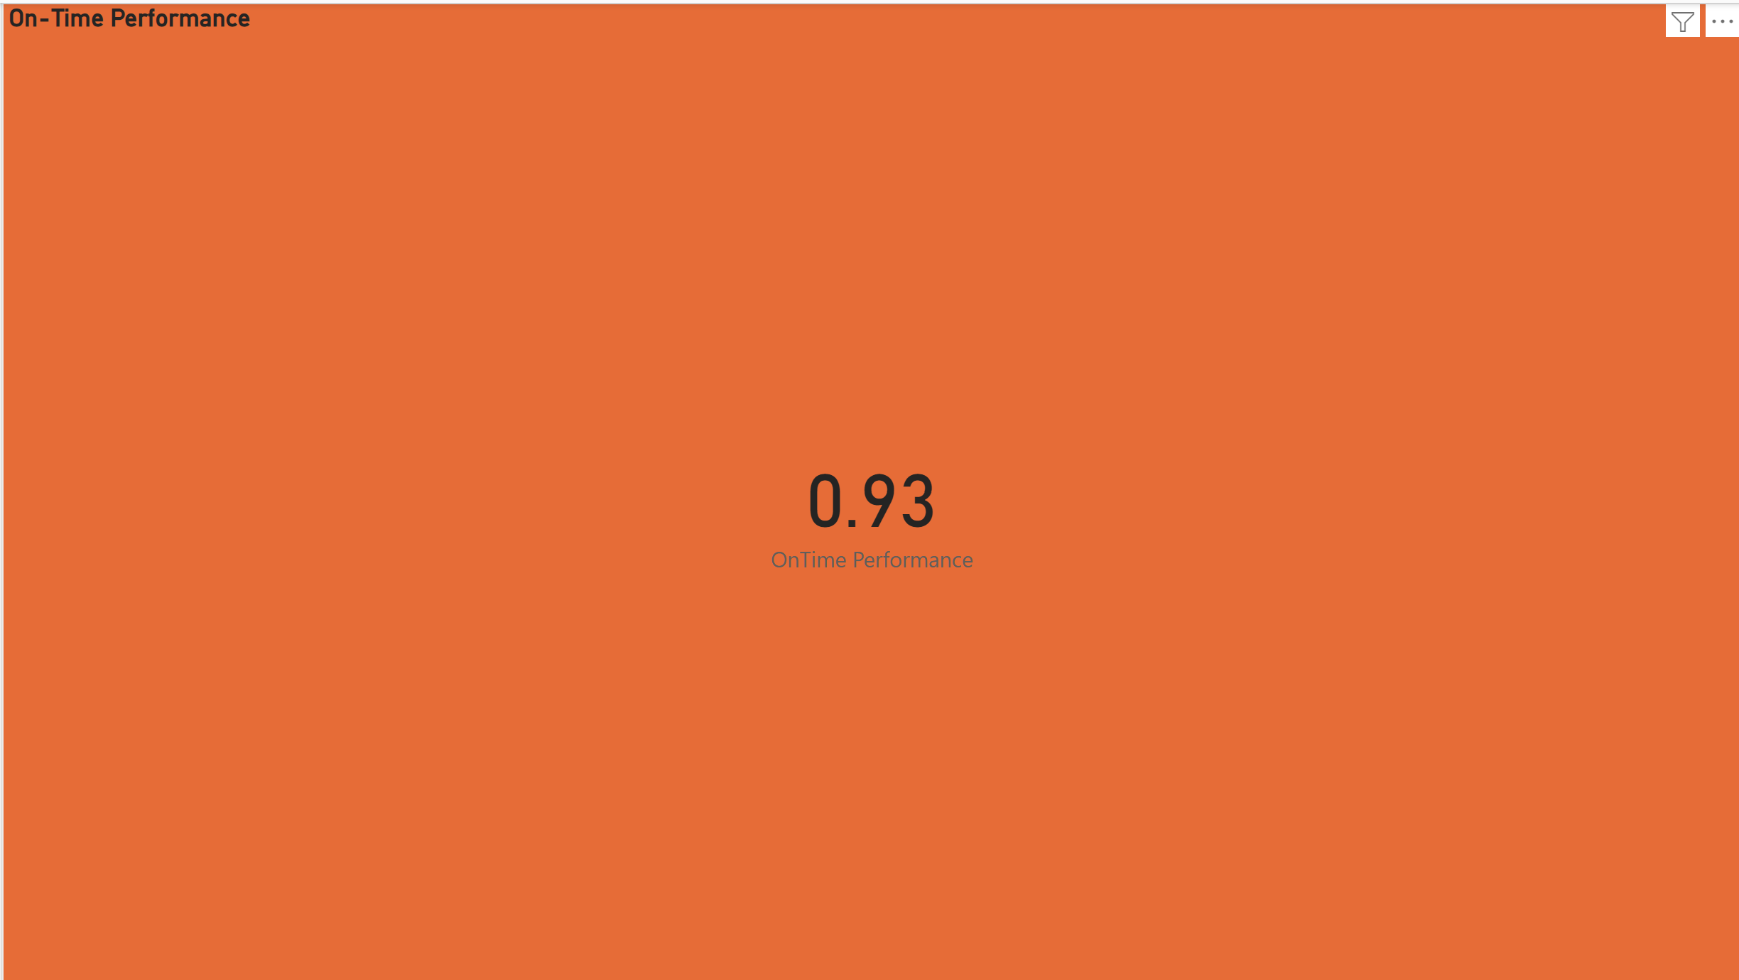
Diagnose on-time performance and contributing factors and many other analysis

Slide 13
On-Time Performance
The overall on-time performance is 93%. This indicates that the majority of trains are arriving on time, with only 7% experiencing delays.

Slide 14
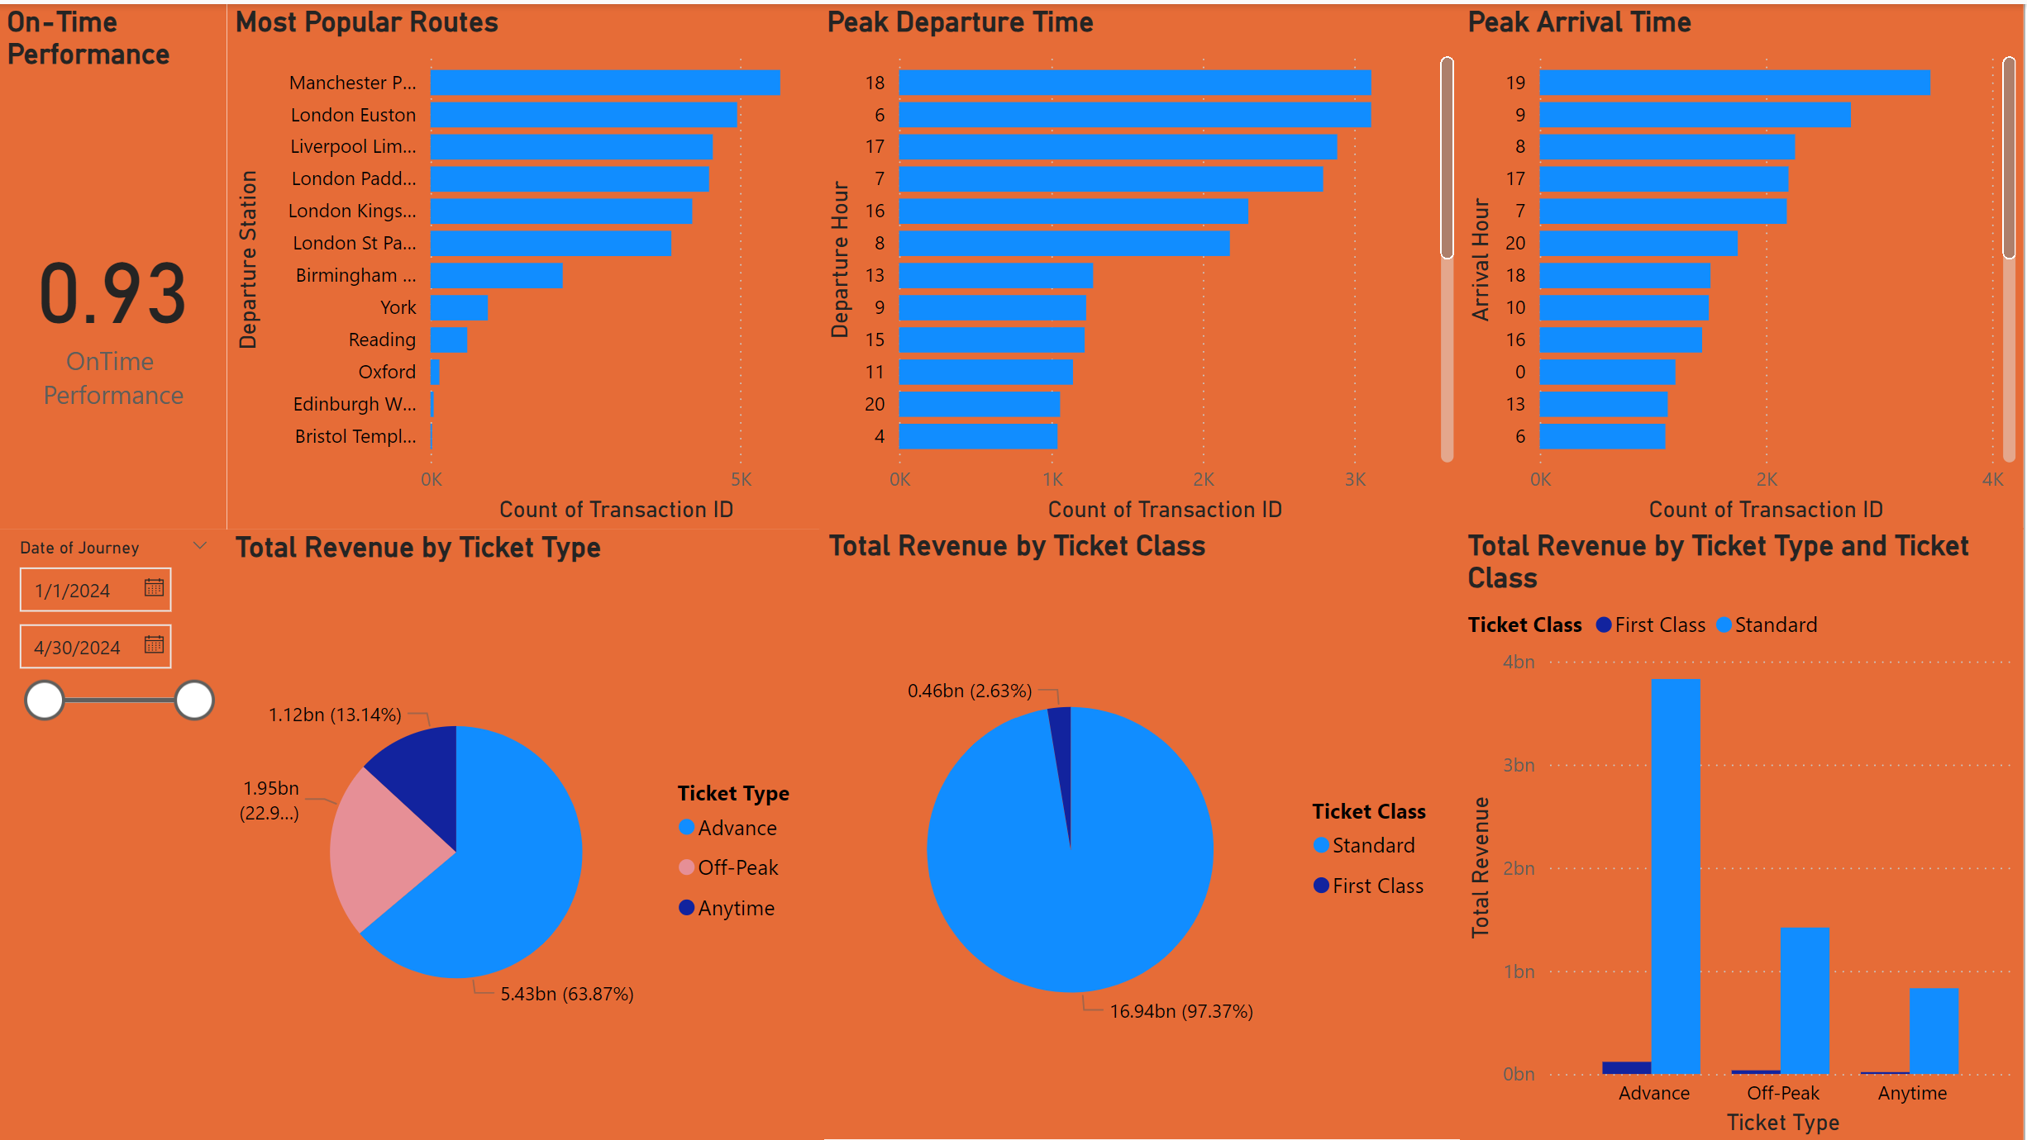
Report of Railway Services UK

Slide 15
Recommendations
Enhance Service During Peak Hours:
Given the high volume of travelers during peak hours, consider adding more services or larger trains during these times to accommodate the demand and reduce overcrowding.
Promote Off-Peak and First-Class Travel:
Since off-peak and first-class tickets generate less revenue, consider marketing strategies or promotions to encourage more usage of these options.

Slide 16
Continued
Focus on Popular Routes for Improvements:
Concentrate improvement efforts and resources on the most popular routes, such as Manchester Piccadilly and London Euston, to enhance passenger experience and operational efficiency.
Monitor and Improve On-Time Performance:
Although on-time performance is relatively high, continue to monitor delays and implement measures to reduce them further. Identifying and addressing specific causes of delays on key routes can enhance overall service reliability.
Advance Ticket Sales:
Given the significant revenue from advance ticket sales, continue to promote and possibly expand advance ticket options to maximize revenue.

